Slide 1







APAC Partner for 2022
Data Analytics | Data Engineering
59 UBI Avenue 1
#07-15 Bizlink Centre
Singapore 408938
FB/B-1 Extension, Second Floor
Mohan Cooperative Industrial Estate,
New Delhi 110044, India
www.lagozon.com
5000 Center Green Way,
Suite 500, Cary
NC 27513, USA

Slide 2
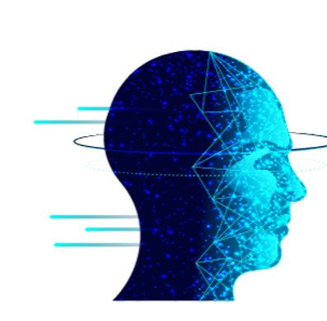
GenAI Use Cases
- Aruna

Slide 3
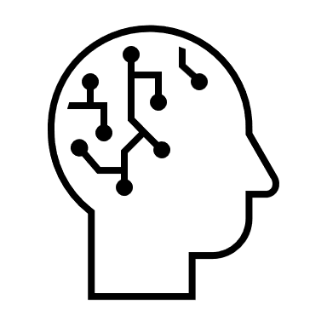





Gen AI Use Cases
Voice Powered Healthcare Assistant
Intelligent Document Processsing for Customer Support
Data Retrieval with AI for Sales
Automated Health Data Assistant
Workforce Attendance Tracking with Facial Recognition & Location
CV shortlisting based on dynamic Job Skills Requirements

Slide 4
Gen AI Key Benefits
Key Benefits
Human Language
Conversation Interface
Data Exploration
Facial Recognition
Summarization
Document Classification
Gen AI models can be trained to understand the intent and meaning behind a user's natural language query. This eliminates the need for users to learn complex database query languages (like SQL)
Gen AI allows for a conversational interface where users can interact with the database in a back-and-forth manner. Users can ask follow-up questions based on the initial results, refine their search criteria, and have a more natural dialogue with the data
Gen AI can be used to automatically classify documents based on their content. This can be helpful for organizing large document collections and making them easier to search and navigate. For example, the AI can categorize documents by department, project, or topic.
AI can go beyond simply retrieving data. It can analyze the results, identify trends and patterns, and provide summaries or insights in natural language. This empowers users to gain deeper understanding from their queries
Gen AI bases systems can generate concise summaries of specific documents or a collection of documents.
Gen AI models can be trained to identify unusual patterns in location data. For instance, if an employee frequently clocks in from a location far outside the geofence, the system can flag it for potential investigation

Slide 5








Use Case-Voice Powered Healthcare Assistant
Problem Statement: Relying on traditional electronic health record searches is slow and inefficient with overwhelming data and complex system
Solution: Implementation of an automated data retrieval system from the database, eliminating the necessity for crafting technical queries. This system operates based on requirements expressed in natural language, streamlining the data retrieval process and enhancing accessibility for non-technical users
Q1. Do I have anything to worry about?
A1. Mr. Lal all your health markers look good. Keep active and Stay fit!
Inquiring Patient
Documents & Data Store
Inquiring Medical Professional
Voice/Text Interface
LZ GenAI App
A2. Here is the summary of Mr. Lal’s report for your follow up assessment.
Q2. Does Mr. Lal need a follow up visit?
Path Lab

Slide 6
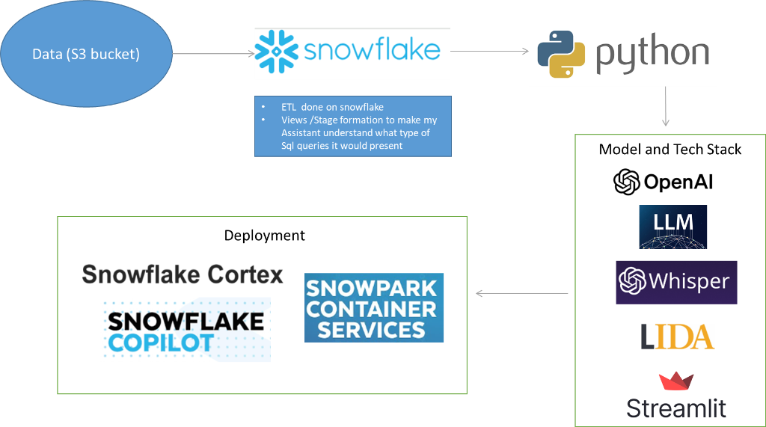
Use Case-Voice Powered Healthcare Assistant
Architecture

Slide 7


Use Case-Intelligent document processsing for Customer Support
Problem Statement: Customer support teams rely heavily on information buried within PDFs like product manuals, CRMs, FAQs and e-mails. Traditional process of manual search is very time consuming, error prone and has limited search functionality. They have to look through multiple systems and screens during the interaction.
Solution: Introduction of an intelligent search system capable of efficiently locating any desired data or text within a specified collection of PDF documents. This technology eliminates the need for manual searching across multiple documents, saving time and enhancing productivity for users.
Q1. Give me contract summary and last interactions with Mr. Lal
Customer Support
Documents Store
Text Interface
LZ GenAI App
A1. Mr. Lal Platinum member contract details here, and last interaction was about new product offer in Jan 2024.
Institution

Slide 8
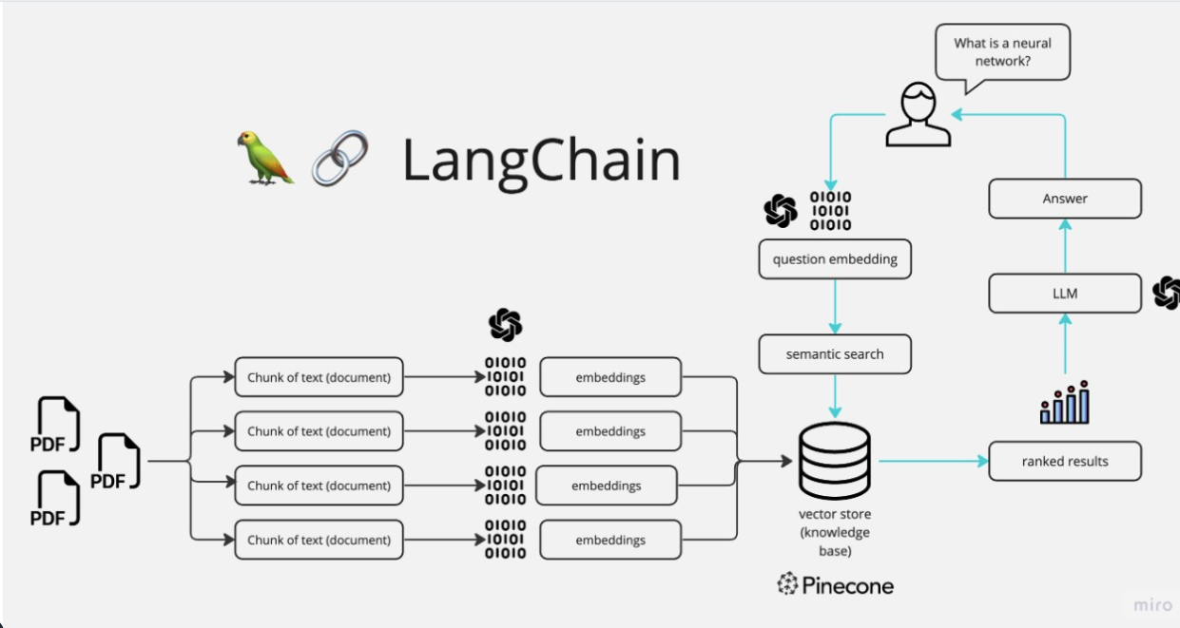
Use Case-Intelligent document processsing for Customer Support
Architecture

Slide 9
Use Case-Data Retrieval with AI for Sales
Problem Statement: Sales team faces challenges with limited insights and missed opportunities due to limited data accessibility and time-consuming process
Solution Implementation of an automated data retrieval system from the database, empowers the sales team member to leverage the power of data to understand deeper details on Customer and personalize their sales pitches with improved efficiency, eliminating the necessity for crafting technical queries.
Q1. Week on Week Growth on Item “SKU#123”?
Salesperson
Voice/Text Interface
LZ GenAI App
Sales Database
A1. Doing great! We are up 5% by revenue on SKU#123

Slide 10


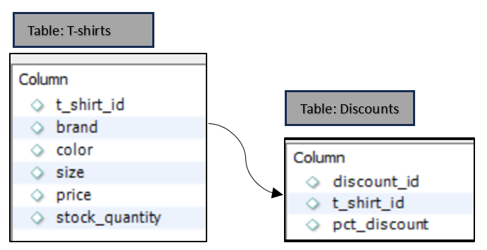
Use Case-Data Retrievel with AI for Sales
Architecture
Give me Month on Month Sales of Item X
The value is 200 for Item X

Slide 11
Use Case-Automated Health Data Assistant
Problem Statement: Current EHR systems create a double burden for healthcare professionals. Cumbersome interfaces slow down access to information and hinder communication with patients, ultimately impacting the quality of care delivered.
Solution: Implementation of an automated system to retrieve details from health reports by Doctors and Patients in plain language eliminates the need for technical know-how, allowing for faster access to important health information and improved communication between patients and caregivers.
Q1. Do I have anything to worry about?
A1. Mr. Lal all your health markers look good. Keep active and Stay fit!
Inquiring Patient
Data Store
Inquiring Medical Professional
Text Interface
LZ GenAI App
A2. Here is the summary of Mr. Lal’s report for your follow up assessment.
Q2. Does Mr. Lal need a follow up visit?
Path Lab

Slide 12
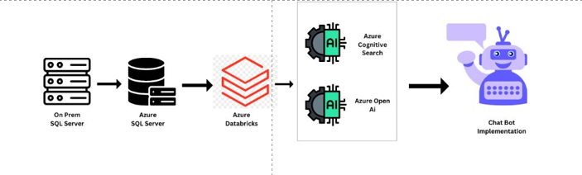
Use Case-Automated Health Data Assistant
Architecture

Slide 13

Use Case-Attendance Tracking with Facial Recognition & Location
Problem Statement: Current approach to workforce attendance tracking relies on manual methods like punch cards or badge swipes which are plagued by inaccuracy, fraud & time-consuming administration
Solution: Workforce Attendance System leverages Gen AI-powered facial recognition and location tracking for a secure and automated solution. This eliminates buddy punching and provides real-time insights to optimize scheduling and boost operational efficiency.
Record my attendance for the day
Staff
Mobile or Laptop
LZ GenAI App
Attendance System
Recorded, Looking Sharp ☺ Thanks Mr. Lal, Entry-9:00 am, Location – Near Head Office

Slide 14
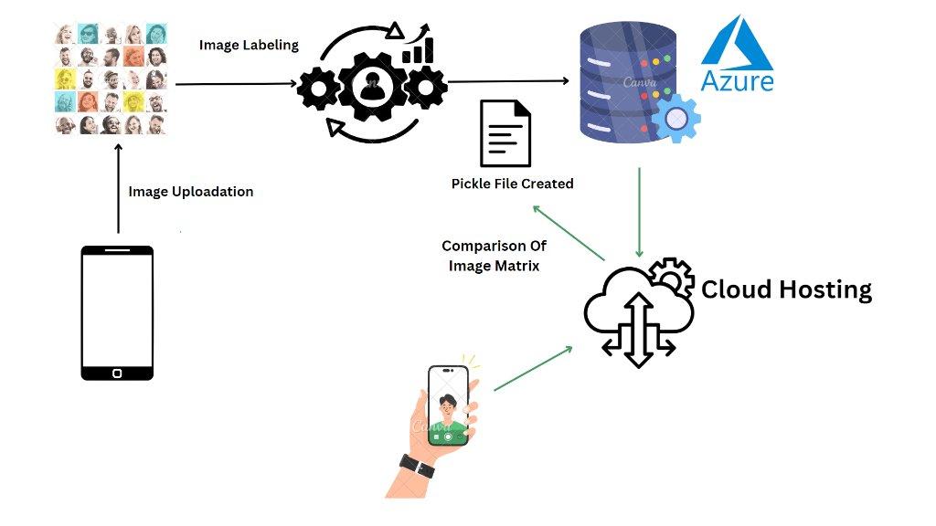
Use Case-Attendance Tracking with Facial Recognition & Location
Architecture

Slide 15


Use Case-CV Shortlisting based on Dynamic Job Skills Requirements
Problem Statement: Traditional CV Shortlisting Misses Qualified Candidates
Solution: Leverage Gen AI for In-Depth Skills Screening and Streamlined Candidate Selection. This advanced system goes beyond traditional resume parsing by analyzing skills and experience with natural language processing
Q1. Screen these 1153 CVs for Mobile App Dev Skills
HR recruiter
LZ Choose Skills in App
LZ GenAI App
CVs Document Store
A1. Here is the list of Mobile App Dev profiles with contact details and link to their CVs

Slide 16
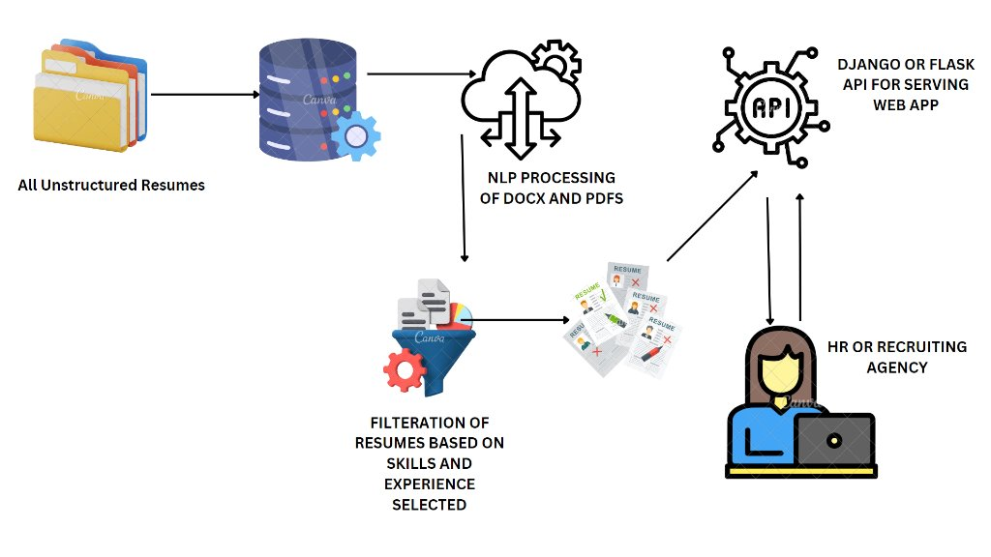
Use Case-CV Shortlisting based on Dynamic Job Skills Requirements
Architecture

Slide 17
Thank You

Slide 18
Key Benefits
Natural Language Understanding (NLU):Gen AI models can be trained to understand the intent and meaning behind a user's natural language query. This eliminates the need for users to learn complex database query languages (like SQL).
Conversational Interface:Gen AI allows for a conversational interface where users can interact with the database in a back-and-forth manner. Users can ask follow-up questions based on the initial results, refine their search criteria, and have a more natural dialogue with the data.
Data Exploration and Summarization:Gen AI can go beyond simply retrieving data. It can analyze the results, identify trends and patterns, and provide summaries or insights in natural language. This empowers users to gain deeper understanding from their queries.
Error Correction and Guidance:Gen AI can identify and correct mistakes in user queries, suggesting alternative phrasing or clarifying ambiguous requests. This improves the overall accuracy and efficiency of data retrieval.
Geospatial Attendance Verification with Anomaly Detection: Gen AI models can be trained to identify unusual patterns in location data. For instance, if an employee frequently clocks in from a location far outside the geofence, the system can flag it for potential investigation.
Liveness Detection: Prevent spoofing attempts (e.g., using photos or videos) by incorporating liveness detection functionalities within the Gen AI model. This can involve blinking detection, head movement recognition, or other methods to ensure a real person is present.
Personalization and Context Awareness:Gen AI models can personalize the search experience by tailoring results based on user history, preferences, and previous queries. This allows for a more relevant and focused data exploration experience.
Document Classification: Gen AI can be used to automatically classify documents based on their content. This can be helpful for organizing large document collections and making them easier to search and navigate. For example, the AI can categorize documents by department, project, or topic.
Question Answering Systems: These AI models are specifically trained on a question-and-answer format using vast amounts of text data. You can train a custom question answering system on your document collection, allowing users to ask specific questions and receive answers directly from the relevant documents.
Information Retrieval (IR) Systems: Traditional IR systems can be enhanced with Gen AI for a more natural search experience. Users can submit queries in natural language, and the Gen AI component can process the query, understand the intent, and translate it into a format suitable for the IR system to search the documents
Summarization: Prompt the LLM to generate concise summaries of specific documents or a collection of documents.

